Slide 1

Chapter 3 Transport Layer
A note on the use of these PowerPoint slides:
We’re making these slides freely available to all (faculty, students, readers). They’re in PowerPoint form so you see the animations; and can add, modify, and delete slides (including this one) and slide content to suit your needs. They obviously represent a lot of work on our part. In return for use, we only ask the following:
If you use these slides (e.g., in a class) that you mention their source (after all, we’d like people to use our book!)
If you post any slides on a www site, that you note that they are adapted from (or perhaps identical to) our slides, and note our copyright of this material.
For a revision history, see the slide note for this page.
Thanks and enjoy! JFK/KWR
All material copyright 1996-2020
J.F Kurose and K.W. Ross, All Rights Reserved
Computer Networking: A Top-Down Approach 8th edition Jim Kurose, Keith Ross Pearson, 2020
Notes:
Version History
8.0 (April 2020)
All slides reformatted for 16:9 aspect ratio
All slides updated to 8th edition material
Use of Calibri font, rather that Gill Sans MT
Add LOTS more animation throughout
added new 8th edition material on QUIC, CUBIC, delay-based congestion control
lighter header font

Slide 2
Internet protocol stack
application: supporting network applications
FTP, SMTP, HTTP
transport: process-process data transfer
TCP, UDP
network: routing of datagrams from source to destination
IP, routing protocols
link: data transfer between neighboring network elements
Ethernet, 802.111 (WiFi), PPP
physical: bits “on the wire”
application
transport
network
link
physical

Slide 3
















Transport services and protocols
application
transport
network
data link
physical
provide logical communication between application processes running on different hosts
mobile network
national or global ISP
transport protocols actions in end systems:
sender: breaks application messages into segments, passes to network layer
receiver: reassembles segments into messages, passes to application layer
logical end-end transport
local or regional ISP
home network
content
provider
network
application
transport
network
data link
physical
datacenter
network
enterprise
network
Notes:
By logical communication , we
mean that from an application’s perspective, it is as if the hosts running the processes
were directly connected; in reality, the hosts may be on opposite sides of the
planet, connected via numerous routers and a wide range of link types. Application
processes use the logical communication provided by the transport layer to send
messages to each other, free from the worry of the details of the physical infrastructure
used to carry these messages.
Let’s look at each of these three (logical communications, actions,

Slide 4
Transport vs. network layer services and protocols
network layer: logical communication between hosts
transport layer: logical communication between processes
relies on, enhances, network layer services

Slide 5
Transport Layer Actions
Sender:
application
application
is passed an application-layer message
app. msg
determines segment header fields values
T_{h}
transport
app. msg
transport
T_{h}
creates segment
network (IP)
network (IP)
passes segment to IP
link
link
physical
physical

Slide 6
Transport Layer Actions
Receiver:
application
receives segment from IP
application
checks header values
transport
transport
app. msg
extracts application-layer message
network (IP)
network (IP)
demultiplexes message up to application via socket
link
link
physical
physical
app. msg
T_{h}

Slide 7
How demultiplexing works
host receives IP datagrams
each datagram has source IP address, destination IP address
each datagram carries one transport-layer segment
each segment has source, destination port number
host uses IP addresses & port numbers to direct segment to appropriate socket
32 bits
source port #
dest port #
other header fields
application
data
(payload)
TCP/UDP segment format

Slide 8
Two principal Internet transport protocols
application
transport
network
data link
physical
TCP: Transmission Control Protocol
reliable, in-order delivery
congestion control
flow control
connection setup
UDP: User Datagram Protocol
unreliable, unordered delivery
no-frills extension of “best-effort” IP
services not available:
delay guarantees
bandwidth guarantees
mobile network
national or global ISP
logical end-end transport
local or regional ISP
home network
content
provider
network
application
transport
network
data link
physical
datacenter
network
enterprise
network

Slide 9

Principles of reliable data transfer
sending process
receiving process
application
data
data
transport
reliable channel
reliable service abstraction
Notes:
note arrows through reliable data transfer channel is just one way – reliably send from sender to receiver

Slide 10
Principles of reliable data transfer
sending process
receiving process
sending process
receiving process
application
data
data
application
data
data
transport
transport
reliable channel
sender-side of
reliable data transfer protocol
receiver-side
of reliable data transfer protocol
reliable service abstraction
transport
network
unreliable channel
reliable service implementation
Notes:
Spend some time talking about how its to the sender and receiver side protocol that IMPLEMENTS reliable data transfer
Communication over unreliable channel is TWO-way: sender and receiver will exchange messages back and forth to IMPLEMENT one-way reliable data transfer

Slide 11
Principles of reliable data transfer
sending process
receiving process
application
data
data
transport
sender-side of
reliable data transfer protocol
receiver-side
of reliable data transfer protocol
Complexity of reliable data transfer protocol will depend (strongly) on characteristics of unreliable channel (lose, corrupt, reorder data?)
transport
network
unreliable channel
reliable service implementation
Notes:
So we have a sender side and a receiver side. How much work they’ll have to do depends on the IMPAIRMENTS introduced by channel – if the channel is perfect – no problem!

Slide 12
Reliable data transfer protocol (rdt): interfaces
rdt_send(): called from above, (e.g., by app.). Passed data to deliver to receiver upper layer
deliver_data(): called by rdt to deliver data to upper layer
sending process
receiving process
rdt_send()
data
data
deliver_data()
data
sender-side
implementation of rdt reliable data transfer protocol
receiver-side
implementation of rdt reliable data transfer protocol
packet
udt_send()
Header
data
Header
data
rdt_rcv()
unreliable channel
udt_send(): called by rdt
to transfer packet over
unreliable channel to receiver
rdt_rcv(): called when packet arrives on receiver side of channel
Bi-directional communication over unreliable channel

Slide 13

rdt3.0: channels with errors and loss
Approach: sender waits “reasonable” amount of time for ACK
retransmits if no ACK received in this time
if pkt (or ACK) just delayed (not lost):
retransmission will be duplicate, but seq #s already handles this!
receiver must specify seq # of packet being ACKed
use countdown timer to interrupt after “reasonable” amount of time
timeout

Slide 14
rdt3.0 sender
rdt_send(data)
sndpkt = make_pkt(0, data, checksum)
udt_send(sndpkt)
start_timer
Wait for
call 0 from above
Wait for ACK0
rdt_rcv(rcvpkt)
&& notcorrupt(rcvpkt)
&& isACK(rcvpkt,1)
rdt_rcv(rcvpkt)
&& notcorrupt(rcvpkt)
&& isACK(rcvpkt,0)
stop_timer
stop_timer
Wait for ACK1
Wait for
call 1 from above
rdt_send(data)
sndpkt = make_pkt(1, data, checksum)
udt_send(sndpkt)
start_timer
Notes:
We see the familiar four state sender from our rdt 2.1 and 2.2 protocols. Top two states when sending packet with zero seq # and bottom two

Slide 15
rdt3.0 sender
rdt_send(data)
rdt_rcv(rcvpkt) &&
( corrupt(rcvpkt) ||
isACK(rcvpkt,1) )
sndpkt = make_pkt(0, data, checksum)
udt_send(sndpkt)
start_timer
rdt_rcv(rcvpkt)
Λ
Λ
Wait for
call 0 from above
Wait for ACK0
timeout
udt_send(sndpkt)
start_timer
rdt_rcv(rcvpkt)
&& notcorrupt(rcvpkt)
&& isACK(rcvpkt,1)
rdt_rcv(rcvpkt)
&& notcorrupt(rcvpkt)
&& isACK(rcvpkt,0)
stop_timer
stop_timer
Wait for ACK1
Wait for
call 1 from above
timeout
udt_send(sndpkt)
start_timer
rdt_rcv(rcvpkt)
rdt_send(data)
Λ
rdt_rcv(rcvpkt) &&
( corrupt(rcvpkt) ||
isACK(rcvpkt,0) )
sndpkt = make_pkt(1, data, checksum)
udt_send(sndpkt)
start_timer
Λ
Notes:
We see the familiar four state sender from our rdt 2.1 and 2.2 protocols. Top two states when sending packet with zero seq # and bottom two

Slide 16

rdt3.0 in action
sender
receiver
sender
receiver
send pkt0
pkt0
send pkt0
pkt0
rcv pkt0
rcv pkt0
ack0
send ack0
ack0
send ack0
rcv ack0
rcv ack0
send pkt1
pkt1
send pkt1
pkt1
rcv pkt1
X
ack1
send ack1
loss
rcv ack1
send pkt0
pkt0
rcv pkt0
timeout
resend pkt1
ack0
send ack0
pkt1
rcv pkt1
ack1
send ack1
rcv ack1
send pkt0
pkt0
(a) no loss
rcv pkt0
ack0
send ack0
(b) packet loss

Slide 17
rdt3.0 in action
sender
receiver
sender
receiver
send pkt0
pkt0
rcv pkt0
send pkt0
pkt0
send ack0
rcv pkt0
rcv ack0
ack0
ack0
send ack0
send pkt1
pkt1
rcv ack0
rcv pkt1
send pkt1
pkt1
send ack1
rcv pkt1
ack1
ack1
send ack1
X
timeout
resend pkt1
loss
pkt1
rcv pkt1
timeout
resend pkt1
rcv ack1
(detect duplicate)
pkt1
rcv pkt1
send ack1
send pkt0
pkt0
ack1
(detect duplicate)
rcv pkt0
rcv ack1
send ack1
rcv ack1
ack1
ack0
send ack0
send pkt0
pkt0
(ignore)
rcv pkt0
ack0
send ack0
pkt1
(c) ACK loss
(d) premature timeout/ delayed ACK

Slide 18
Performance of rdt3.0 (stop-and-wait)
U _{sender}: utilization – fraction of time sender busy sending
example: 1 Gbps link, 15 ms prop. delay, 8000 bit packet
time to transmit packet into channel:
L
8000 bits
D_{trans} =
=
=
8 microsecs
R
10⁹ bits/sec
Notes:
if RTT=30 msec, 1KB pkt every 30 msec: 33kB/sec thruput over 1 Gbps link
network protocol limits use of physical resources
Let’s develop a formula for utilization

Slide 19
rdt3.0: stop-and-wait operation
sender
receiver
first packet bit transmitted, t = 0
first packet bit arrives
RTT
last packet bit arrives, send ACK
ACK arrives, send next
packet, t = RTT + L / R

Slide 20
rdt3.0: stop-and-wait operation
sender
receiver
L / R
=
L/R
U_{sender}
RTT
+ L / R
.008
RTT
=
30.008
=
0.00027
rdt 3.0 protocol performance stinks!
Protocol limits performance of underlying infrastructure (channel)

Slide 21
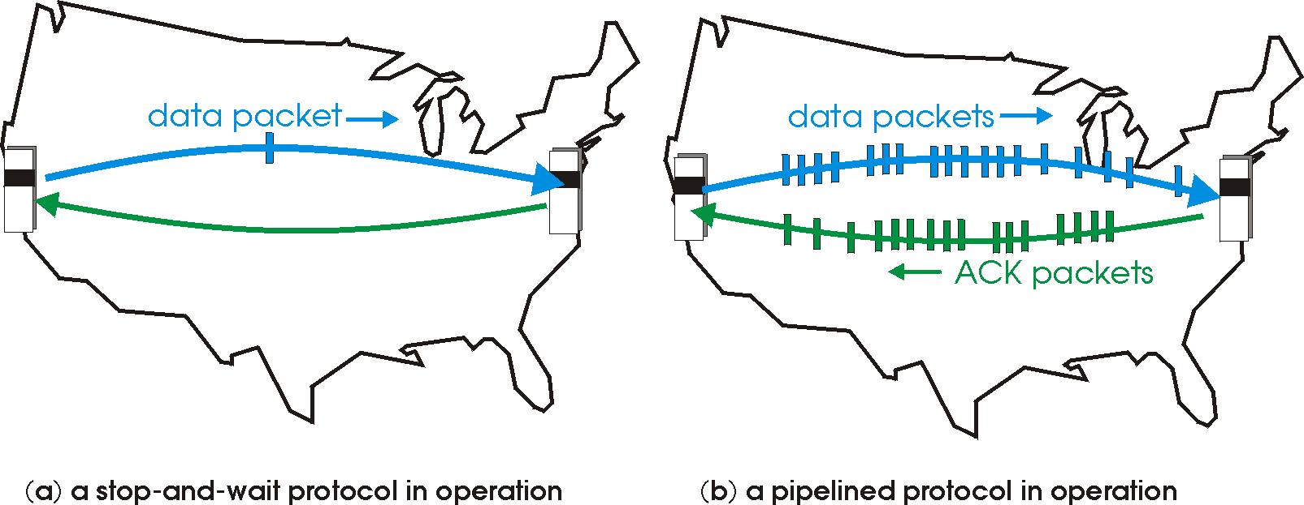
rdt3.0: pipelined protocols operation
pipelining: sender allows multiple, “in-flight”, yet-to-be-acknowledged packets
range of sequence numbers must be increased
buffering at sender and/or receiver

Slide 22
Pipelining: increased utilization
sender
receiver
first packet bit transmitted, t = 0
last bit transmitted, t = L / R
first packet bit arrives
RTT
last packet bit arrives, send ACK
last bit of 2nd packet arrives, send ACK
last bit of 3rd packet arrives, send ACK
ACK arrives, send next
packet, t = RTT + L / R
3-packet pipelining increases
utilization by a factor of 3!
Notes:
two generic forms of pipelined protocols: go-Back-N, selective repeat

Slide 23
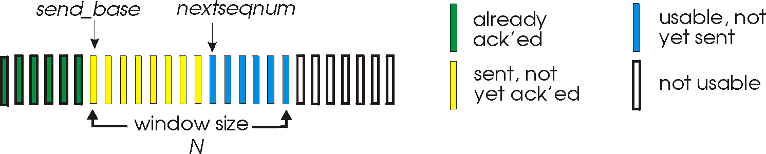
Go-Back-N: sender
sender: “window” of up to N, consecutive transmitted but unACKed pkts
k-bit seq # in pkt header
cumulative ACK: ACK(n): ACKs all packets up to, including seq # n
on receiving ACK(n): move window forward to begin at n+1
timer for oldest in-flight packet
timeout(n): retransmit packet n and all higher seq # packets in window
Notes:
window size of 14, 8 have been sent but are not yet ackowledgedm 6 sequence numbers are available for us. In woindow, but no calls from above to use them.
Note – we’ll skip the Go-Back-N FSM specification you can chack that out in powerpoitn slides or book)
TCP uses cumulative ACK

Slide 24
Go-Back-N: receiver
ACK-only: always send ACK for correctly-received packet so far, with highest in-order seq #
may generate duplicate ACKs
need only remember rcv_base
on receipt of out-of-order packet:
can discard (don’t buffer) or buffer: an implementation decision
re-ACK pkt with highest in-order seq #
Receiver view of sequence number space:
received and ACKed
…
…
Out-of-order: received but not ACKed
rcv_base
Not received
Notes:
Note – we’ll skip the Go-Back-N FSM specification (actually it’s

Slide 25
Go-Back-N in action
sender window (N=4)
sender
receiver
0 1 2 3 4 5 6 7 8
send pkt0
send pkt1
send pkt2
send pkt3
(wait)
0 1 2 3 4 5 6 7 8
receive pkt0, send ack0
receive pkt1, send ack1
receive pkt3, discard,
(re)send ack1
0 1 2 3 4 5 6 7 8
X
0 1 2 3 4 5 6 7 8
loss
0 1 2 3 4 5 6 7 8
rcv ack0, send pkt4
0 1 2 3 4 5 6 7 8
rcv ack1, send pkt5
receive pkt4, discard,
(re)send ack1
ignore duplicate ACK
receive pkt5, discard,
(re)send ack1
pkt 2 timeout
0 1 2 3 4 5 6 7 8
send pkt2
send pkt3
send pkt4
send pkt5
0 1 2 3 4 5 6 7 8
0 1 2 3 4 5 6 7 8
rcv pkt2, deliver, send ack2
rcv pkt3, deliver, send ack3
rcv pkt4, deliver, send ack4
rcv pkt5, deliver, send ack5
0 1 2 3 4 5 6 7 8
Notes:
Let’s skip FSM specification for GBN – check out the book or ppt – and let’s watch GBN sender and receivers in action.
Let assume a window size of 4. at t=0, sender sends packets 0, 1, 2 3, 4, and packet 2 will be lost
At the receiver:
Packet 0 received ACK0 generated
Packet 1 received ACK1 generated
Packet 2 is lost, and so when packet 3 is received, ACK 1 is sent – that’s the cumulative ACK, re-Acknowledging the receipt of packet 1. and in this implementation packet 3 is discarded

Slide 26
Selective repeat
receiver individually acknowledges all correctly received packets
buffers packets, as needed, for eventual in-order delivery to upper layer
sender times-out/retransmits individually for unACKed packets
sender maintains timer for each unACKed pkt
sender window
N consecutive seq #s
limits seq #s of sent, unACKed packets
Notes:
An important mechanism of GBN was the use of the cumulative acknowledgements, and as we mentioned, cumulative ACKs are used in TCP
An alternate ACK mechanism would be for the receiver to indiviually acknowledge specific packets as they are received. This mechanism is at the heart of the Selective repeat protocol.

Slide 27
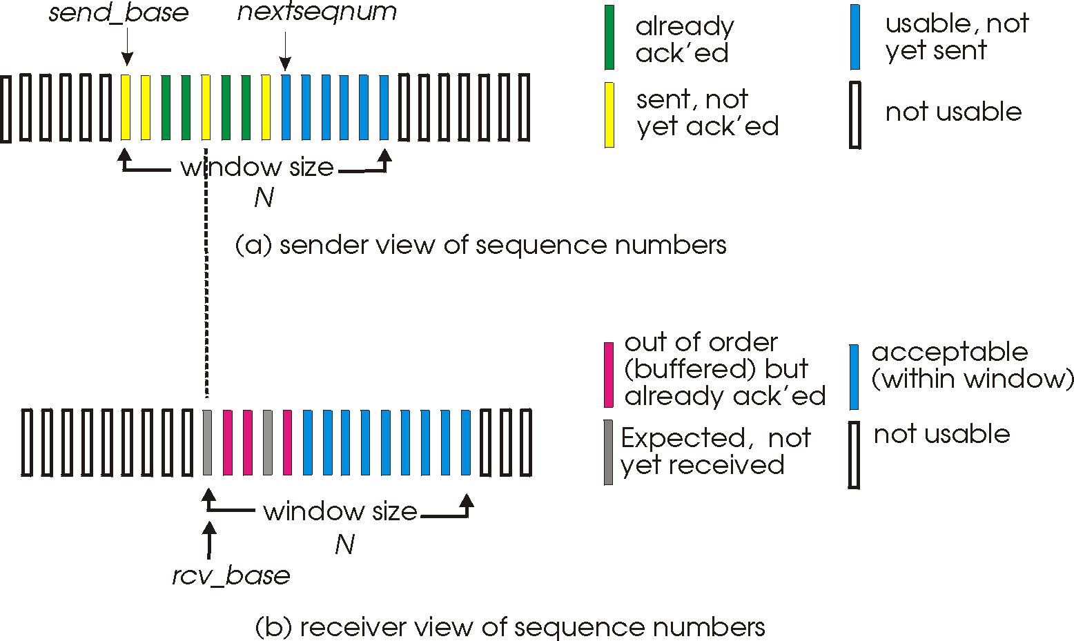
Selective repeat: sender, receiver windows

Slide 28
Selective repeat: sender and receiver
sender
receiver
data from above:
if next available seq # in window, send packet
timeout(n):
resend packet n, restart timer
ACK(n) in [sendbase,sendbase+N]:
mark packet n as received
if n smallest unACKed packet, advance window base to next unACKed seq #
packet n in [rcvbase, rcvbase+N-1]
send ACK(n)
out-of-order: buffer
in-order: deliver (also deliver buffered, in-order packets), advance window to next not-yet-received packet
packet n in [rcvbase-N,rcvbase-1]
ACK(n)
otherwise:
ignore
Notes:
If the packet is in order, its data will be delivered, as will any buffered data that can now be delived in order

Slide 29
Selective Repeat in action
sender window (N=4)
sender
receiver
0 1 2 3 4 5 6 7 8
send pkt0
send pkt1
send pkt2
send pkt3
(wait)
0 1 2 3 4 5 6 7 8
receive pkt0, send ack0
receive pkt1, send ack1
receive pkt3, buffer,
send ack3
0 1 2 3 4 5 6 7 8
X
0 1 2 3 4 5 6 7 8
loss
0 1 2 3 4 5 6 7 8
rcv ack0, send pkt4
0 1 2 3 4 5 6 7 8
rcv ack1, send pkt5
receive pkt4, buffer,
send ack4
record ack3 arrived
receive pkt5, buffer,
send ack5
pkt 2 timeout
0 1 2 3 4 5 6 7 8
send pkt2
(but not 3,4,5)
0 1 2 3 4 5 6 7 8
0 1 2 3 4 5 6 7 8
rcv pkt2; deliver pkt2,
pkt3, pkt4, pkt5; send ack2
0 1 2 3 4 5 6 7 8
Q: what happens when ack2 arrives?

